Slide 1
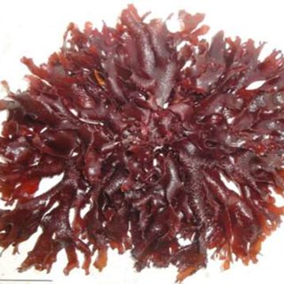
Senegal seaweed especiallyMeristotheca senegalensis
View of exploitation
Ndeye Coumba Bousso, PhD –student, 28.04.2022

Slide 2
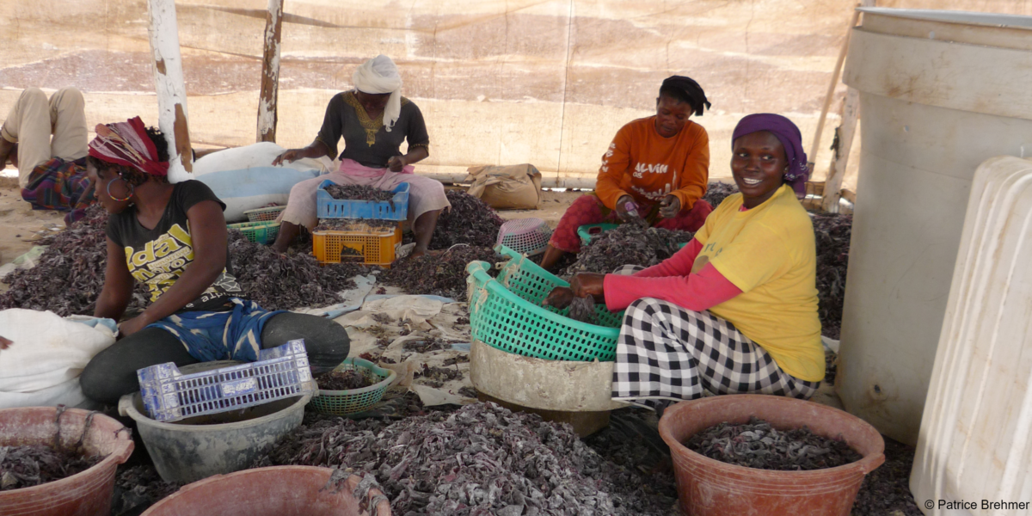
Processing of seaweed on the Senegalese coast. Foto: Patrice Brehmer. IRD©2019. [36]
Transformation des macroalgues sur la côte sénégalaise
Brehmer Patrice, IRD. (2019). Processing of seaweed on the Senegalese coast [Image numérique]. Récupérée sur :
https://meerwissen.org/partnership-projects/climalg-sn

Slide 3
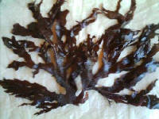
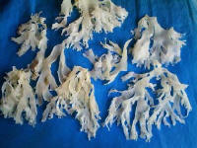
Meristotheca senegalensis
Bleached Meristotheca senegalensis for Japan
Algues marines Sénégal. Algues, triage et chargement [Image numérique]. Récupérée sur :
http://www.export-forum.com/africa/fr/senegal_algues_marines-1.htm

Slide 4
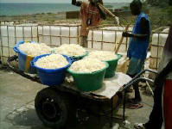
Préparation des algues pour l’exportation : triage et chargement
Algues marines Sénégal. Algues, triage et chargement [Image numérique]. Récupérée sur :
http://www.export-forum.com/africa/fr/senegal_algues_marines-1.htm

Slide 5
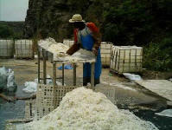
Préparation des algues pour l’exportation : triage et chargement
Algues marines Sénégal. Algues, triage et chargement [Image numérique]. Récupérée sur :
http://www.export-forum.com/africa/fr/senegal_algues_marines-1.htm

Slide 6
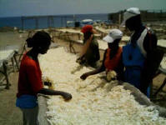
Préparation des algues pour l’exportation : triage et chargement
Algues marines Sénégal. Algues, triage et chargement [Image numérique]. Récupérée sur :
http://www.export-forum.com/africa/fr/senegal_algues_marines-1.htm

Slide 7
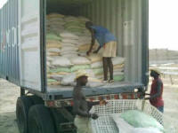
Préparation des algues pour l’exportation : triage et chargement
Algues marines Sénégal. Algues, triage et chargement [Image numérique]. Récupérée sur :
http://www.export-forum.com/africa/fr/senegal_algues_marines-1.htm

Slide 8
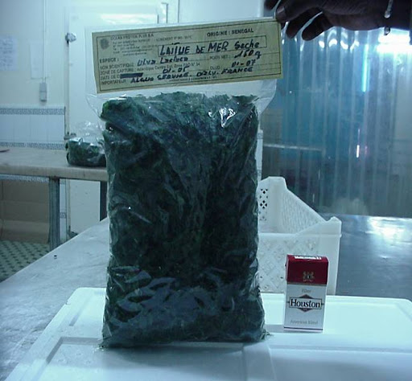
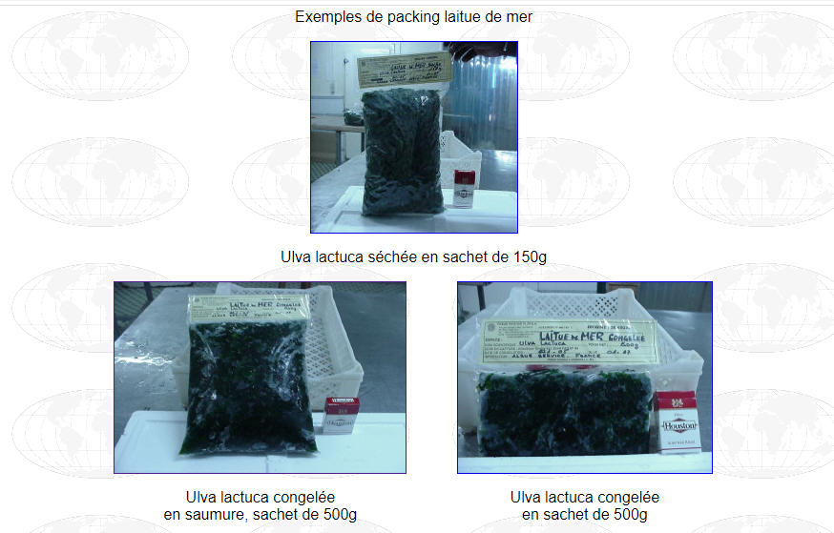
Packaging of ulva
http://www.export-forum.com/africa/fr/senegal_algues_marines.htm

Slide 9
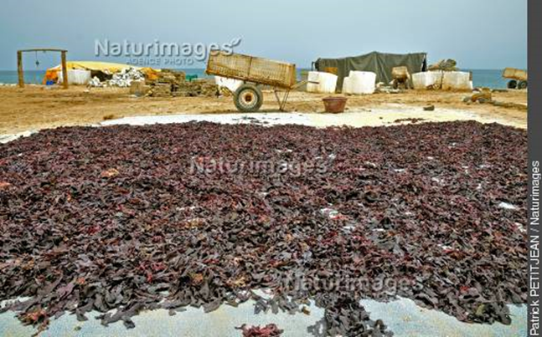
Récolte des algues. Photo: Patrick PETIT JEAN. Naturimages.
Séchage des macroalgues au soleil (Meristotheca senegalensis)
Patrick Petit Jean, Naturimages. (Dakar). Récolte des algues [Image numérique]. Récupérée sur :
https://www.naturimages.com/fr/reportages/metier/exploitation-des-algues-au-senegal-frx1addedac7110000000001512.htm

Slide 10
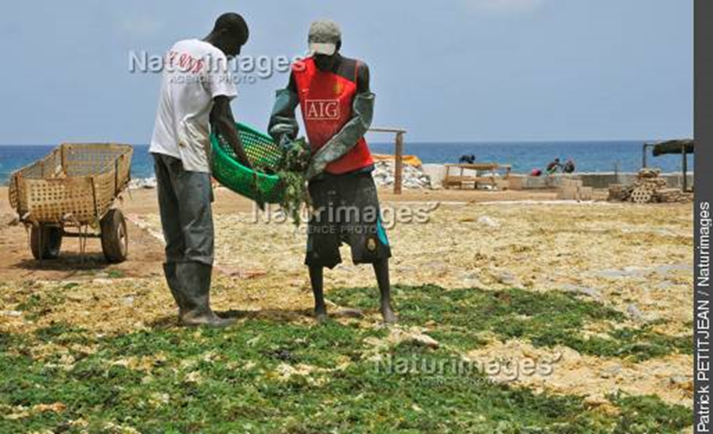
Récolte des algues. Photo: Patrick PETIT JEAN. Naturimages.
« Cette image montre des ouvriers qui étalent des algues sur des bâches afin d'y être séchées naturellement au soleil. »
Patrick Petit Jean, Naturimages. (Dakar). Récolte des algues [Image numérique]. Récupérée sur :
https://www.naturimages.com/fr/reportages/metier/exploitation-des-algues-au-senegal-frx1addedac7110000000001512.htm

Slide 11
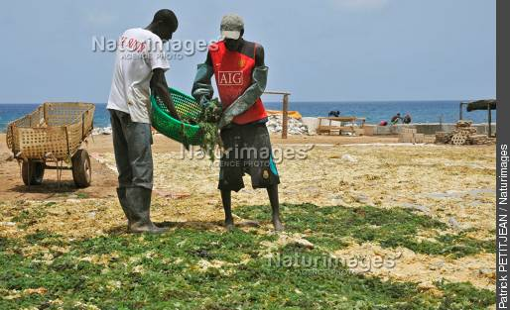
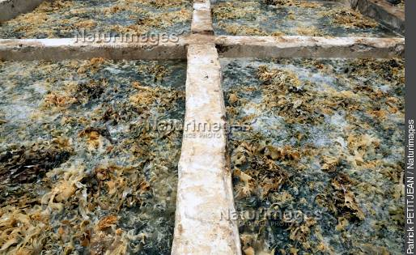
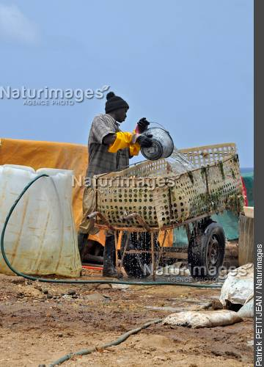
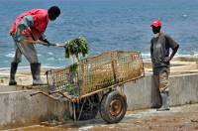
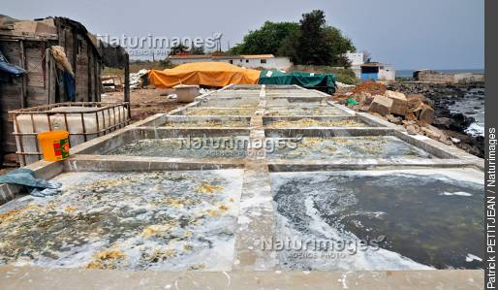
Patrick Petit Jean, Naturimages. (Dakar). Récolte des algues [Image numérique]. Récupérée sur :
https://www.naturimages.com/fr/reportages/metier/exploitation-des-algues-au-senegal-frx1addedac7110000000001512.htm
Récolte des algues. Photo: Patrick PETIT JEAN. Naturimages.

Slide 12
OU EN EST ON AVEC L’EXPLOITATION ARTISANALE ?
Absence infrastructures adéquates
Absence équipements nécessaires

Slide 13
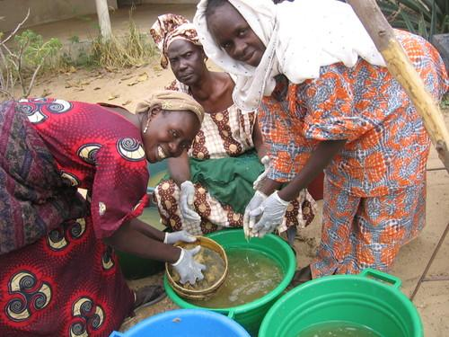
Lavage des macroalgues à Ngaparou. « Les femmes nettoyant les algues; remarquer le tamis. Elles les rincent plusieurs fois afin de les débarrasser du sel, des débris et autres minéraux en excès. »
ONG SOS Environnement Sénégal Ngaparou. Transformation des algues marines Ngaparou.
https://sosenvironnement.typepad.com/photos/ngaparou_seaweed_processi/index.html

Slide 14
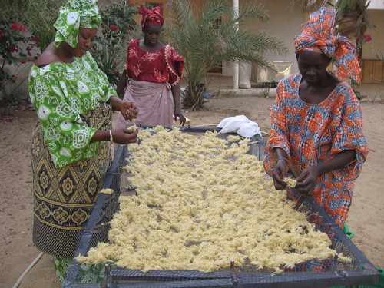
Séchage des macroalgues avec l’utilisation de tables comme supports « ...l'eau de javel a vraiment décolorée, comme vous le dira cette femme. L'eau de javel n'est utilisée que pour la production du carraghénane »
ONG SOS Environnement Sénégal Ngaparou. Transformation des algues marines Ngaparou.
https://sosenvironnement.typepad.com/photos/ngaparou_seaweed_processi/index.html

Slide 15
Processing of seaweed on the Senegalese coast. Foto: Patrice Brehmer. IRD©2019. [36]
Transformation des macroalgues sur la côte sénégalaise
Brehmer Patrice, IRD. (2019). Processing of seaweed on the Senegalese coast [Image numérique]. Récupérée sur :
https://meerwissen.org/partnership-projects/climalg-sn

Slide 16
Food Safety in link with the exploitation view of seaweed in Senegal
Meristotheca senegalensis
Food Safety
HACCP Method for seaweed
Heavy metals
Processing of seaweed
Currently in Senegal, only a few species (Meristotheca senegalensis, Hypnea musciformis) are harvested, packaged and exported to Japan and China. The operation takes place mainly in Ngor and Pointe des Almadies and consists of a washing stage, followed by drying and finally packaging. However, the lack of minimum health standards, adequate infrastructure and necessary equipment throughout the production chain (from harvest to packaging) can lead to health risks that can affect the proper use of seaweed intended for export.
After export Meristotheca is intended for food purposes as evidenced by the following extract :“For his part, Bodian has long been interested in macroalgae, the kinds that grow in the ocean like weeds and whose forms are as numerous as can be imagined: some with broad leaves like lettuce and others full of fine, stringy tendrils. He says that he has never heard of his Senegalese ancestors using seaweed in their culinary traditions. However, he likes to remind people here that seaweed is versatile and can be used in cosmetics or as a food additive or, yes, eaten directly for its health benefits and taste. Meristotheca senegalensis, for example, was first harvested here to make carrageenan, an additive that shows up in everything from soy milk to toothpaste. But a second wave of exporters started sending it to Japan where it is known as tosaka nori and eaten like salad.” Source: https://news.algaeworld.org/2016/02/teach-a-man-to-farm-seaweed-hell-eat-even-if-fisheries-collapse/
In short, food security relative to the exploitation is a requirement in this present (because Meristotheca is used for food purposes outside, perhaps also for the production of carrageenan) and remains a way to be studied for a future use of algae in the 'food. Moreover, there is a report from the Ministry of Fisheries which makes the following recommendations “Provisions for a sustainable development of the algae resource in Senegal: authorizations, permits, licenses, operating areas, measures aimed at the protection of certain species of algae, health standards, handling rules , storage, processing and conservation of seaweed, the conditions for recovery and export: approvals and technical specifications” Source: Rapport des journées de réflexion sur le développement de la filière « algues marines » au Sénégal. République du Sénégal. Ministère de l’Economie maritime et des Transports maritimes internationaux. Direction de la Gestion et de l’Exploitation des Fonds marins (DGEFM), 2006. 31 p.
https://drive.google.com/file/d/1hBxgu67IsSH50BKAK3Lg7v_styoTx3lh/view?usp=sharing
Now Purpose: study and improve the current artisanal exploitation of macroalgae from Senegal intended for export (even to develop the local market) by proposing processes that meet the health standards required by importing countries. The HACCP (Hazard Analysis Critical Control Point) methodology known as “hazard analysis and critical control points” will be implemented. The HACCP method for seaweed is well documented in this document https://seagrant.uconn.edu/wp-content/uploads/sites/1985/2020/01/Seaweed-Hazards-Guide_Jan2020_accessible.pdf. Knowledge of the composition of heavy metals according to the place of harvest and cultivation also remains an objective.

Slide 17
Nutritional value in link with the exploitation view of seaweed in Senegal
Meristotheca senegalensis
Food Safety
HACCP Method for seaweed
Nutritional value : iodine…
Processing of seaweed
1) Meristotheca senegalensis being a good source of minerals and iodine, addressing the concept of food safety and bioavailability of nutrients minerals like iodine during food processing will support the recommendations of Senegalese scientists who find that we can introduce Meristotheca seaweed into food products to increase their nutritional value. « Although M. senegalense is considered as a rich source of iodine, the FDA and other world dietary guidance programs warn that consumption of excess iodine rich seaweeds could be dangerous for health (Brownlee et al., 2012; Leung and Braverman, 2014). An example of the potential health risk was reported by Brownlee et al. (2012), when seaweed was used in a study composed of lactating mothers in Japan and Korea. They found that the high concentrations of iodine in seaweed were transmissible from mother to infant through breast milk which could result in neonatal iodine toxicity and subsequent hypothyroidism or hyper-thyroidism. However, M. senegalense could be very valuable in new foods which are rich in iodione. Currently new types of foods are been developed using M. senegalense as a source of some important nutrients such calcium, magnesium and iron as well as iodine. The increase of the local consumption of this endemic seaweed in spite of exportation will also induce development of local markets. Like other seaweed, M. senegalense could be an important source of nutrients, iodine, minerals and vitamin B12. These results also show that these red algae can be added to the human diet and diversify world food sources however, further studies are needed in order to boost the added value of M. senegalense. Farming of M. senegalense could promote diversification of fishing activities reducing pressure on other marine resources and contributing to sustainable food production.”
https://www.researchgate.net/publication/314079249_African_Journal_of_Food_Science_Nutritional_composition_of_Meristotheca_senegalense_Rhodophyta_A_new_nutrient_source
2) Integration of seaweed in the culinary art of Senegal: What strategy? How to implement the use of seaweed in Senegalese culinary dishes, once the bioavailability of nutrients from Meristotheca senegalensis during food processing is well understood. How to implement the use of seaweed in Senegalese culinary dishes, once the bioavailability of nutrients from Meristotheca senegalensis during food processing is well understood? This is one of the most challenging areas of enhancement: because the Senegalese community attach great importance to the organoleptic quality of the dishes: thus knowing the variation of amino acids such as glutamic acid (umami taste) during processing and seaweed cultivation is very important.
Now Purpose: in addition to food safety, addressing the concept of bioavailability of nutrients minerals like iodine during food processing

Slide 18
Cultivation in link with the exploitation view of seaweed in Senegal
Meristotheca senegalensis
Food Safety
HACCP Method for seaweed
Nutritional value : iodine…
Processing of seaweed
Cultivation of seaweed
Skills and communication
To support a sustainable use of Meristotheca we must understand in detail the cultivation of this species. And now comparing the qualitative and quantitative composition of nutrients like iodine… will allow us to see the variation between wild Meristotheca senegalensis and cultivated Meristotheca senegalensis. We need also to take account skills and communication: the good harvests of seaweed, the organization of harvesters (fishermen, divers, women processors) in association. This organization in association will allow them to standardize the price of the kg of seaweed. The harvesters sell the kg of Meristotheca between 100 francs and 125 francs to intermediaries who are responsible for reselling the seaweed to the Chinese and Japanese. Harvesters find the selling price per kg very low and want to increase the price per kg. Hence the need to take into account skills and communication to standardize the Meristotheca senegalensis market.
Now Purpose: in addition to food safety, addressing the concept of bioavailability of nutrients minerals like iodine during food processing and deep study of Meristotheca senegalensis cultivation, skills and communication are very important

Slide 19
Thank you so much

